Slide 1
Prevent Disruptive Behavior
in TechConnect Zoom Meetings
Presented by:
LUCY LIDOT & HEATHER SCHMIDT
June 29 - July 1, 2022
Silver Linings: Reflecting. Revisioning. Rising

Slide 2
Learning Objectives
Determine the level of security risk that your meeting has
Have a better understanding of your Zoom security options
Know the security tools available in-meeting to best manage your session
June 29 - July 1, 2022

Slide 3
Agenda
Prevent Disruptive Behavior in TechConnect Zoom Meetings
Examples of intrusions
Recipe for successful, secure TechConnect Zoom meeting
Adjust settings (web portal, scheduler, in-meeting)
Manage meeting attendees
Know in-meeting and post-meeting security options
Questions and Answers
June 29 - July 1, 2022

Slide 4
Prevent Disruptive Behavior in TechConnect Zoom Meetings
By a show of hands, have you ever been in a meeting that was interrupted by an unwanted guest…
June 29 - July 1, 2022

Slide 5
Prevent Disruptive Behavior in TechConnect Zoom Meetings
Think about how they may have gotten access to the meeting…
What did they do while they were in the meeting?
June 29 - July 1, 2022

Slide 6
Prevent Disruptive Behavior in TechConnect Zoom Meetings
Examples of intrusions
Random number/bot-generated meeting ID
Meeting link is posted on social media
Attendee shares meeting link with others
Attendee impersonation
Host drops out of meeting
Meeting held in PMI
June 29 - July 1, 2022

Slide 7
Prevent Disruptive Behavior in TechConnect Zoom Meetings
Recipe for a successful, secure meeting…
Closest to webinar experience
Secures default settings for newly scheduled meetings
Doesn’t completely limit interaction; many settings can be adjusted in-meeting
June 29 - July 1, 2022

Slide 8
Prevent Disruptive Behavior in TechConnect Zoom Meetings
Recipe for a successful, secure meeting…
Step 1:
Log into the TechConnect Zoom web portal. Click on Settings and verify/update 35 settings.
June 29 - July 1, 2022

Slide 9
Prevent Disruptive Behavior in TechConnect Zoom Meetings
Recipe for a successful, secure meeting…
Step 2:
When scheduling meeting in the web portal, confirm default settings and enable registration.
June 29 - July 1, 2022

Slide 10
Prevent Disruptive Behavior in TechConnect Zoom Meetings
Recipe for a successful, secure meeting…
Step 3:
Join your meeting early enough to confirm in-meeting default settings and disable two additional settings before allowing attendees from waiting room.
June 29 - July 1, 2022

Slide 11
Prevent Disruptive Behavior in TechConnect Zoom Meetings
Recipe for a successful, secure meeting…
Step 4:
Know the security options available to you in the live meeting just in case. Take action during meeting or after meeting if an intrusion occurs.
June 29 - July 1, 2022

Slide 12
Most important portal settings
Prevent Disruptive Behavior in TechConnect Zoom Meetings
Waiting Room Everyone will go in the waiting room Place participants in the waiting room if the host and co-hosts are not present or if they lose connection during a meeting | Enable Enable Enable
Participants Video | Disable
Allow participants to join before host | Disable
Mute all participants when they join a meeting | Enable
Chat Allow participants to chat with hosts and cohosts | Enable Enable
Private chat | Disable
Send files via meeting chat | OK to Enable if Chat restricted to host
June 29 - July 1, 2022

Slide 13
Most important portal settings
Prevent Disruptive Behavior in TechConnect Zoom Meetings
Screen sharing Host only can share | Enable Enable
Annotation Only the user who is sharing can annotate | Enable Enable
Whiteboard | OK to Enable if Screen Sharing restricted to host
Allow removed participants to rejoin | Disable
Allow participants to rename themselves | Disable
Allow host or co-hosts to rename participants in the waiting room | Enable
Hide participants profile pictures in a meeting | Enable
Focus Mode | Enable
June 29 - July 1, 2022

Slide 14
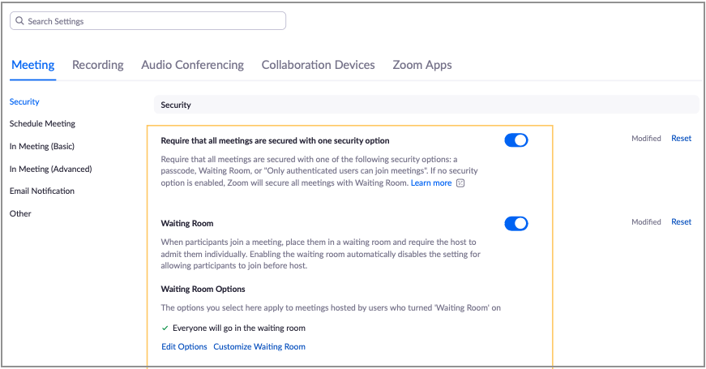
Remaining Settings
Prevent Disruptive Behavior in TechConnect Zoom Meetings
June 29 - July 1, 2022

Slide 15
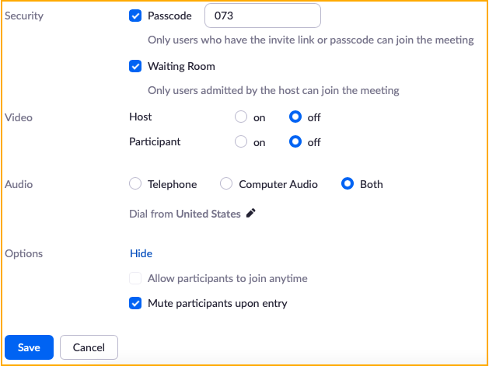
When Scheduling Meeting
Prevent Disruptive Behavior in TechConnect Zoom Meetings
Confirm default settings:
Meeting ID - generate automatically - Enabled
Passcode - Enabled
Waiting room - Enabled
Participant video - Disabled
Mute participants upon entry- Enabled
June 29 - July 1, 2022

Slide 16
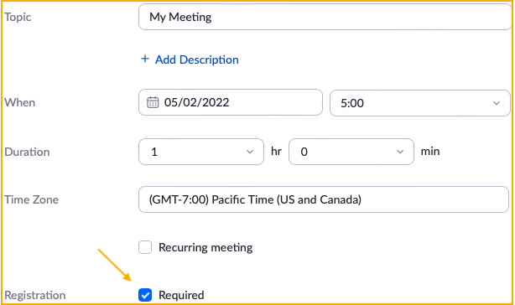
When Scheduling Meeting
Prevent Disruptive Behavior in TechConnect Zoom Meetings
Manually enable and require:
Registration
Finish scheduling and save meeting
June 29 - July 1, 2022

Slide 17
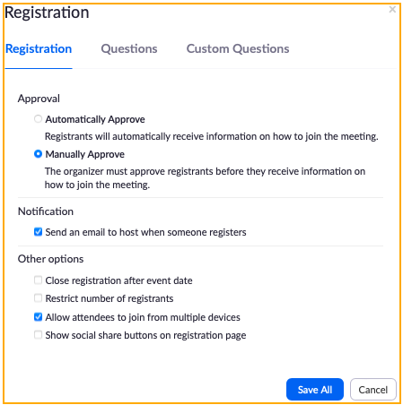
When Scheduling Meeting
Prevent Disruptive Behavior in TechConnect Zoom Meetings
Scroll down to saved meeting details and edit registration options:
Enable Manually approve
Enable Send email to host when someone registers
Disable Show social share buttons on registration page
June 29 - July 1, 2022

Slide 18
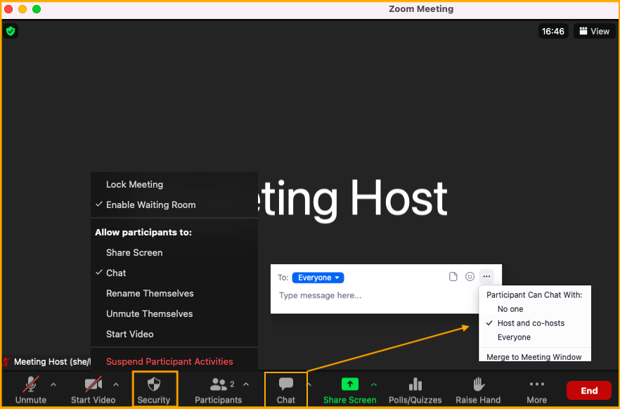
In the Meeting
Prevent Disruptive Behavior in TechConnect Zoom Meetings
Join meeting early to…
Confirm default settings:
Chat - Participants can chat with Host/Cohost only
Waiting room - Enabled
Share Screen - Disabled
Disable Allow Participants to:
Unmute themselves
Start video
June 29 - July 1, 2022

Slide 19
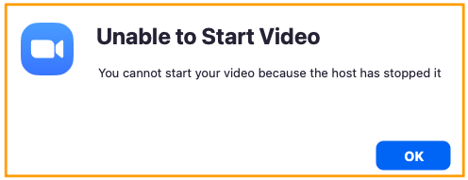
Attendee will be unable to…
Prevent Disruptive Behavior in TechConnect Zoom Meetings
June 29 - July 1, 2022

Slide 20
Attendee will be unable to…
Prevent Disruptive Behavior in TechConnect Zoom Meetings
June 29 - July 1, 2022

Slide 21
Attendee will be unable to…
Prevent Disruptive Behavior in TechConnect Zoom Meetings
June 29 - July 1, 2022

Slide 22
What is attendee able to do?
Prevent Disruptive Behavior in TechConnect Zoom Meetings
Chat to host/cohosts
Hand Raise
You stay in control of the meeting while having attendees ask permission to participate through chat and hand raise.
June 29 - July 1, 2022

Slide 23
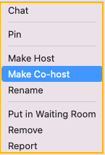
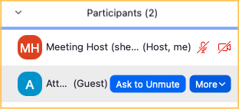
Granting Participant Permission to Participate
Prevent Disruptive Behavior in TechConnect Zoom Meetings
In the Participant list:
Hover over participant and click to prompt attendee to unmute OR
Click More to make attendee co-host to share screen, chat to all, share video
June 29 - July 1, 2022

Slide 24
Allowing ALL to Participate
Prevent Disruptive Behavior in TechConnect Zoom Meetings
Click on security icon to allow participants to unmute themselves, share video, rename themselves, share screen, annotate (if host is screen sharing), and chat
IF you do allow all to participate…
June 29 - July 1, 2022

Slide 25
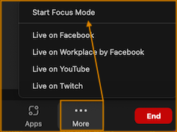
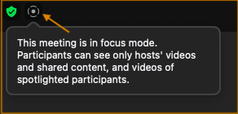
Consider Using Focus Mode
Prevent Disruptive Behavior in TechConnect Zoom Meetings
Participants see videos of host, co-host, and spotlighted participants only
When screen sharing, participant can only view their own content alongside the host, but no one else will see the shared screen unless the host shares the participant’s screen with others in the meeting
June 29 - July 1, 2022

Slide 26
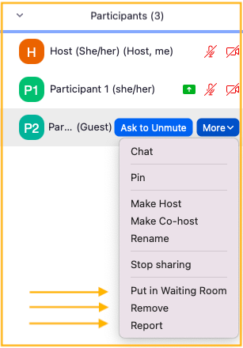
If Disruptive Behavior Occurs
Prevent Disruptive Behavior in TechConnect Zoom Meetings
From Participant list:
Put in waiting room
Remove participant
Report participant
June 29 - July 1, 2022

Slide 27
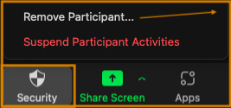
If Disruptive Behavior Occurs
Prevent Disruptive Behavior in TechConnect Zoom Meetings
From Security icon:
Remove and report participant
Suspend participant activities
June 29 - July 1, 2022

Slide 28
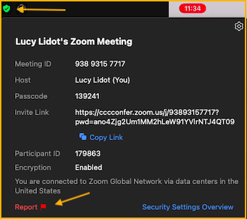
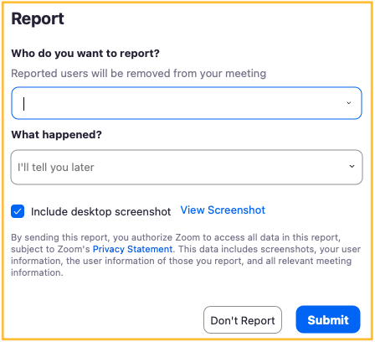
If Disruptive Behavior Occurs
Prevent Disruptive Behavior in TechConnect Zoom Meetings
From green shield check mark icon in top left corner:
Report
June 29 - July 1, 2022

Slide 29
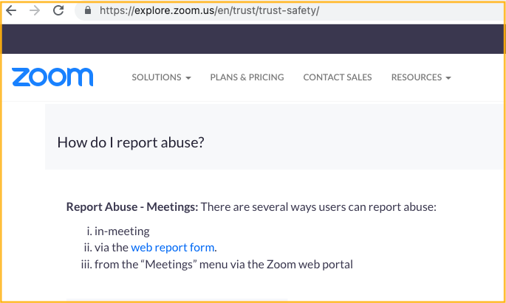
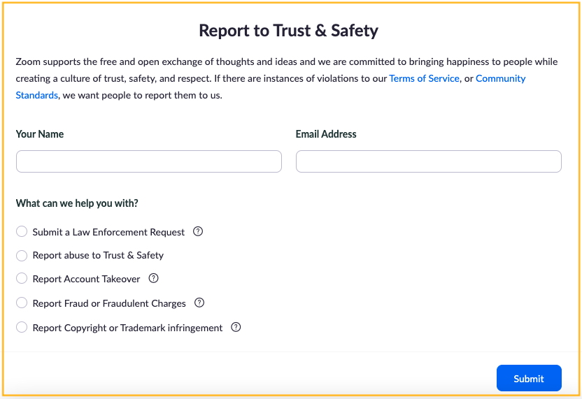
Report Incident Post Meeting
Prevent Disruptive Behavior in TechConnect Zoom Meetings
Campus IT can contact support@ccctechconnect.org
Zoom Trust & Safety https://explore.zoom.us/en/trust/trust-safety/
June 29 - July 1, 2022

Slide 30
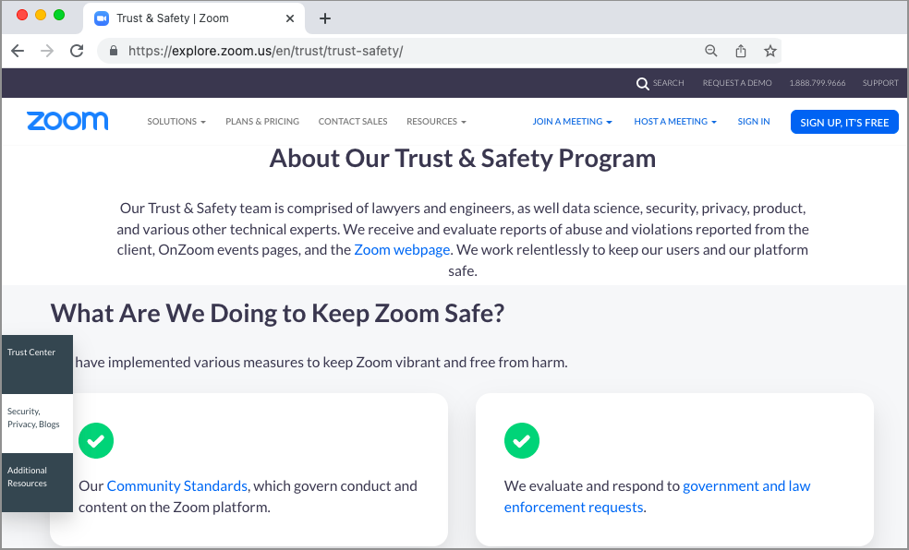
Zoom Trust & Safety
Prevent Disruptive Behavior in TechConnect Zoom Meetings
June 29 - July 1, 2022

Slide 31
Any questions? Feel free to ask!
Questions?
June 29 - July 1, 2022

Slide 32
CCC TechConnect
Contact us!
CCC TechConnect c/o Palomar College 1140 W. Mission Road San Marcos, CA 92069
Email: support@ccctechconnect.org Website: https://www.ccctechconnect.org Support Website: https://ccctechconnect.zendesk.com
Thank you for joining today!
June 29 - July 1, 2022

