Slide 1
Presented by:
Leveraging CMS tools to support proficiency based grading in online science classes
K. Allison Lenkeit Meezan
June 29 - July 1, 2022
Equity in Online Teaching

Slide 2
Overview
Overview of proficiency based grading in Physical Geography
Discuss how Canvas tools can be applied to create a transparent course
Discuss how a proficiency based course builds student agency
Describe how Canvas tools can reduce instructor workload
Review the results of 1 year of proficiency based grading in Geography 1
June 29 - July 1, 2022

Slide 3
Proficiency based grading: An exercise in backward design
Course Outcomes
Unit Outcomes
Formative Assessments
June 29 - July 1, 2022

Slide 4
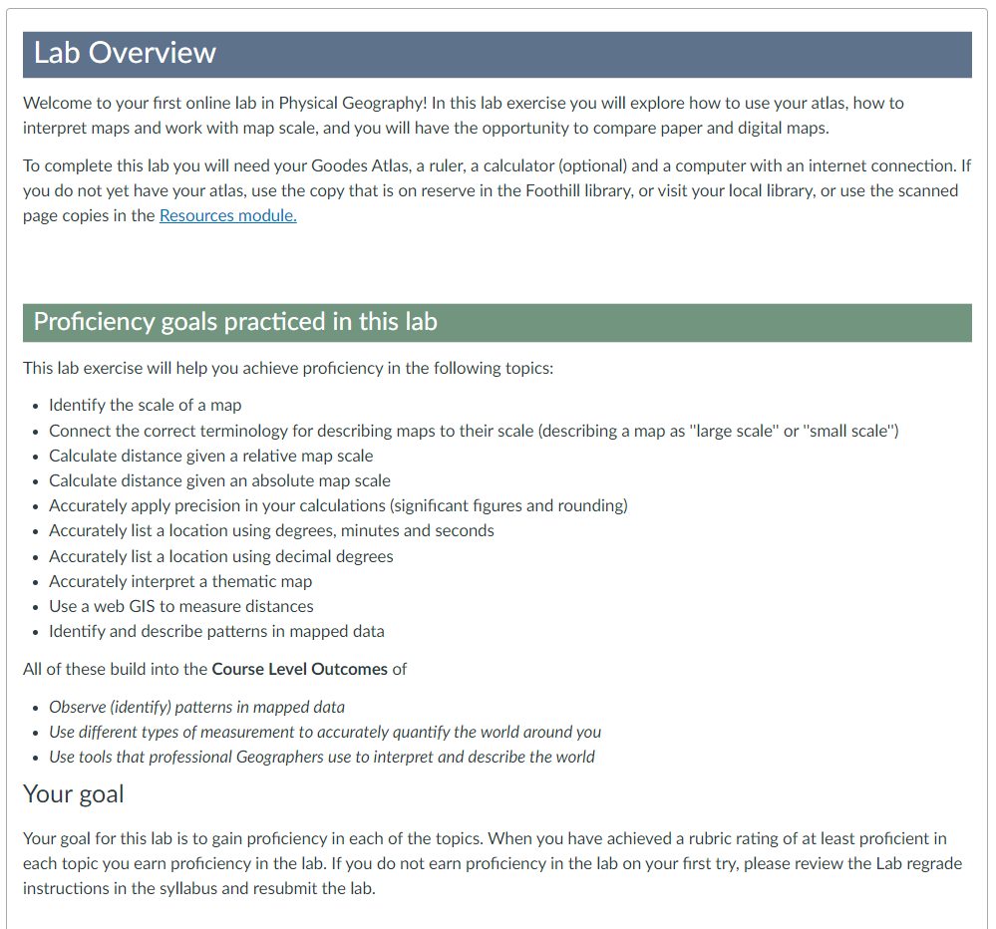
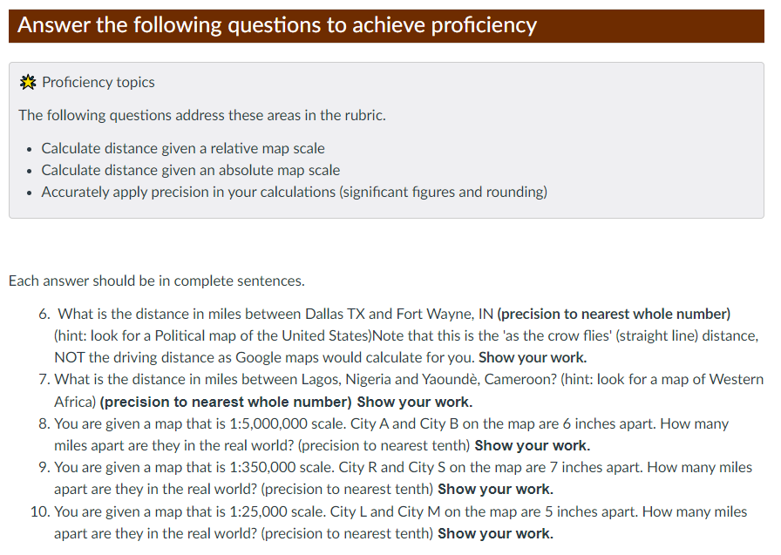
Assess proficiency on each outcome
June 29 - July 1, 2022

Slide 5
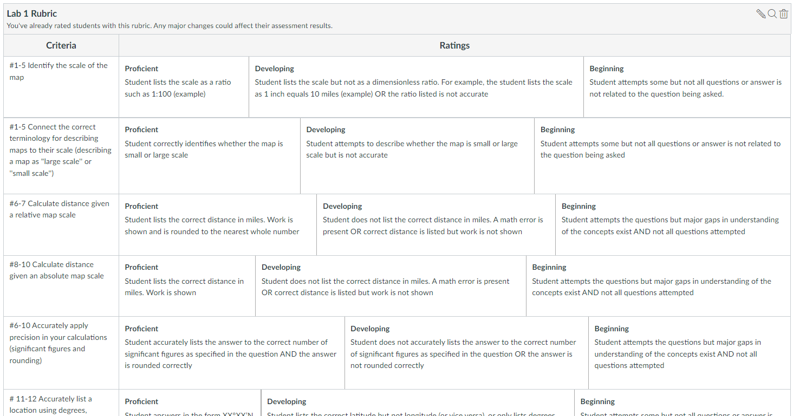
Use the CMS tools to facilitate assessment and transparency
June 29 - July 1, 2022

Slide 6
Proficiency on each objective removes the grey area of grading
June 29 - July 1, 2022

Slide 7
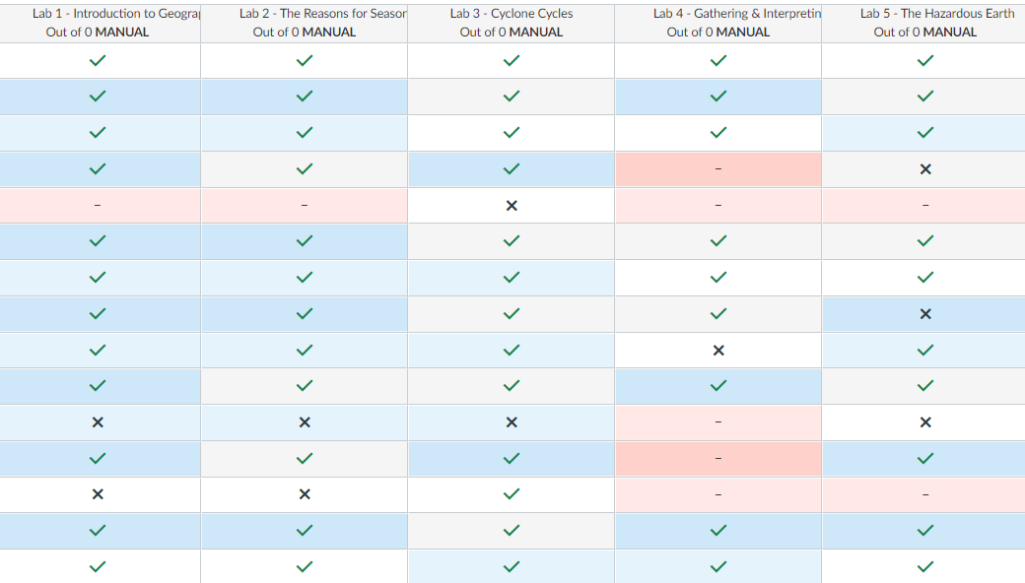
Complete/Incomplete grading
June 29 - July 1, 2022

Slide 8
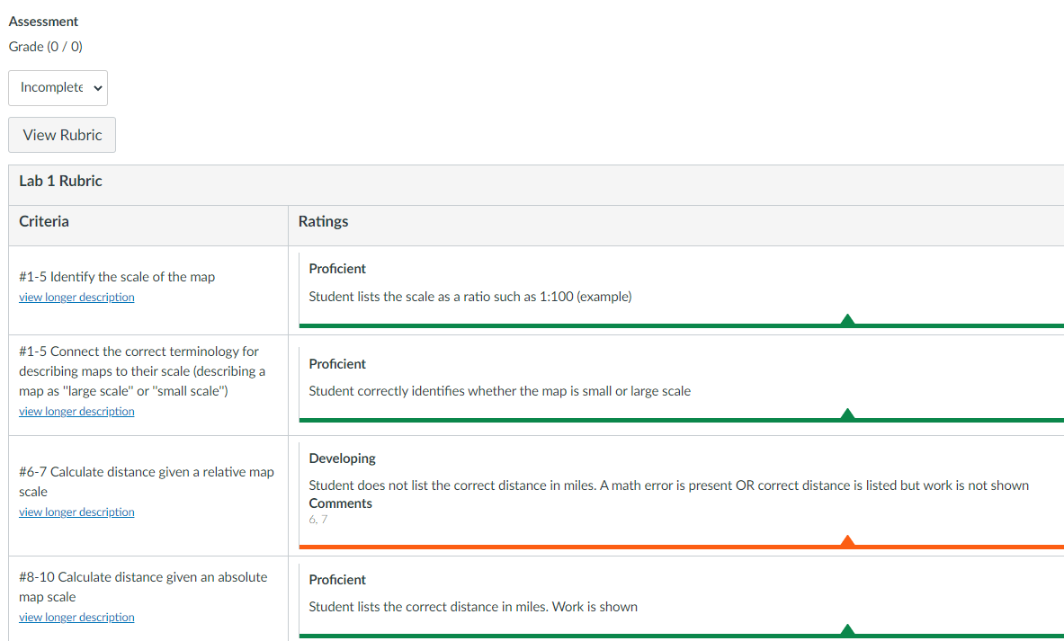
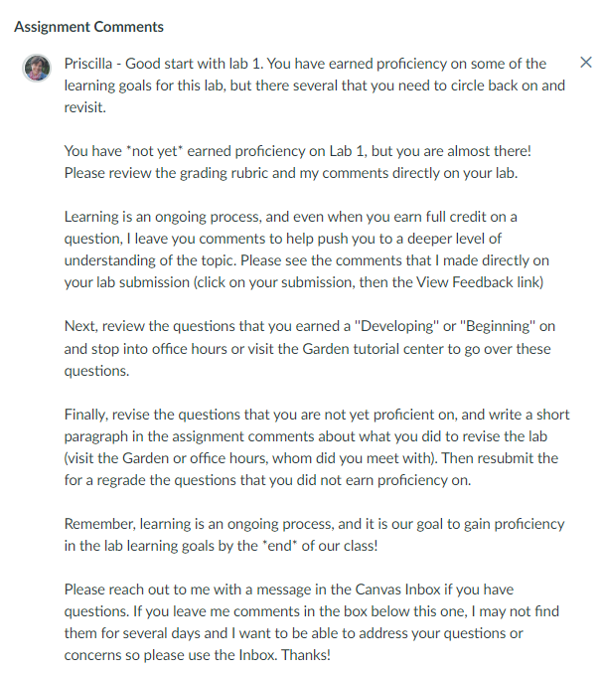
Use the CMS tools to facilitate assessment and transparency
June 29 - July 1, 2022

Slide 9
Use the CMS tools for a high touch online classroom
Use the Gradebook ‘Message Students Who’ to reach out
Provide question-level feedback using markup tools
Provide individualized assignment feedback with Assignment Comments
June 29 - July 1, 2022

Slide 10
How Proficiency Based Grading Works in This Class
June 29 - July 1, 2022

Slide 11
Benefits of Proficiency Based Grading
Focus is on mastering concepts/skills
Students engage in an iterative process that mirrors life-long learning
Centers a growth mindset
Removes the ‘gamification’ of grades
June 29 - July 1, 2022

Slide 12
Proficiency based grading: Language matters
You are not proficient yet
Your goal: Become a confident user of the skills
Exemplary
Proficient
Learning milestones
Developing
Beginning
June 29 - July 1, 2022

Slide 13
Three R’s Revisit, review & revise
June 29 - July 1, 2022

Slide 14
Proficiency based grading builds student agency
June 29 - July 1, 2022

Slide 15
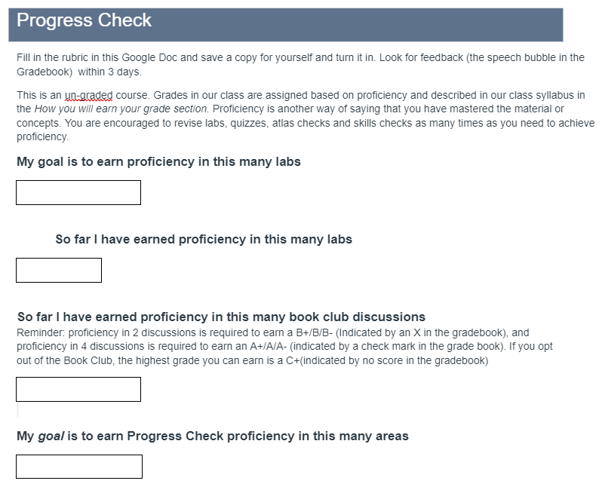
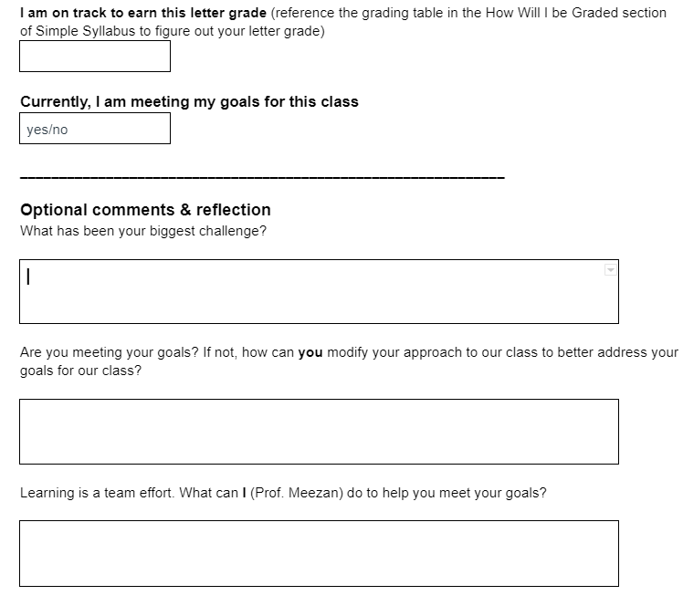
Building Student Agency: Progress self checks
June 29 - July 1, 2022

Slide 16
Building Student Agency
Norm the ‘three R’s’: Revisit, Review, Revise
Revisions are a normal part of the learning process
Push to engage in productive struggle
June 29 - July 1, 2022

Slide 17
Trajectory of the Term
Honeymoon
Anything is possible!
Reality Check
Nothing is possible!
Productive Struggle
Proficiency I can do it!
“I guess I cannot just wing it in this class”
“I really like this because it emphasizes learning and not just completing an assignment to get a grade (which doesn't necessarily mean you learned)”
“Thank you for giving us a chance to revise, it takes the pressure off”
“Because it was based on proficiency it pushed me harder to learn and to work on applying what I learned in developing skills that I might not have otherwise achieved had I taken a traditional class. I found this experience hard, but very, very beneficial”
June 29 - July 1, 2022

Slide 18
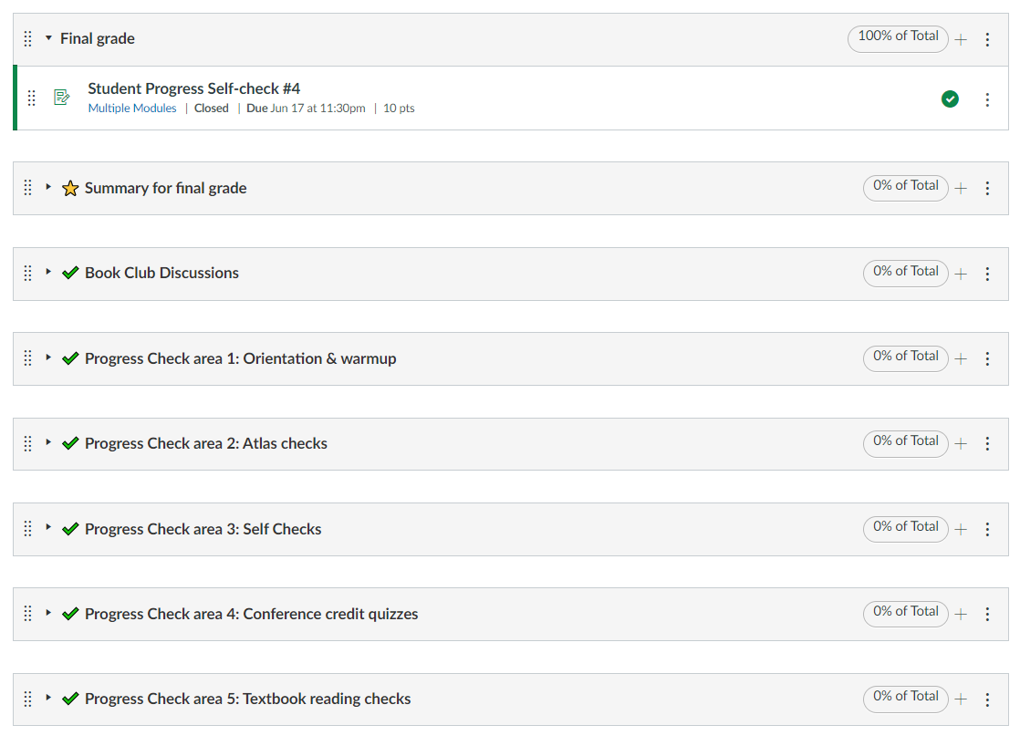
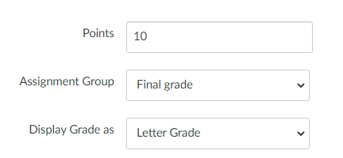
Leveraging the CMS: Final Grades
June 29 - July 1, 2022

Slide 19
Results: Disproportionate Impact
 | 2019-2021 Success point gap (13 sections) | 2021-2022 Success point gap (4 sections)
African American | -49 | -28
Asian | 12 | 13
Latinx | -9 | -10
Low Income | -8 | -16
June 29 - July 1, 2022

Slide 20
Success on Formative Assessments
34%
34%
46%
60%
53%
89%
86%
86%
75%
78%
June 29 - July 1, 2022

Slide 21
Overall
90% retention (final grades/enrolled at census)
71% success rate
June 29 - July 1, 2022

Slide 22
Take-Aways
Proficiency based grading empowers students to take agency for their learning
Breaking down content into unit level objectives allows students to focus on mastering course material
Ongoing instructor engagement with individuals using CMS tools is critical
Leverage the CMS tools to streamline feedback and grading
June 29 - July 1, 2022

Slide 23
Learning Objectives
Describe how course and unit level outcomes can be applied to create a transparent and equitable teaching environment that builds a deep level of understanding of the course material.
Demonstrate how CMS tools can be leveraged to create a high-touch, high engagement virtual learning environment that reduces instructor workload.
Discuss how applying CMS tools in a proficiency based grading environment can empower students to take ownership of their class grade and their learning.
June 29 - July 1, 2022

Slide 24
Contact Information
Thank you!
K. Allison Lenkeit Meezan
Foothill College
meezankaren@foothill.edu; 650-949-7166
June 29 - July 1, 2022

