Slide 1
Getting Started, Moving Forward: Reflection & Revision for Online Equity
Sandy Haynes
Professor of Art History
Pasadena City College
Katie Datko
Director of Distance Learning & Instructional Technology
Mt. SAC College
Text Equivalent of Presentation
June 29 - July 1, 2022
Presented by:

Slide 2
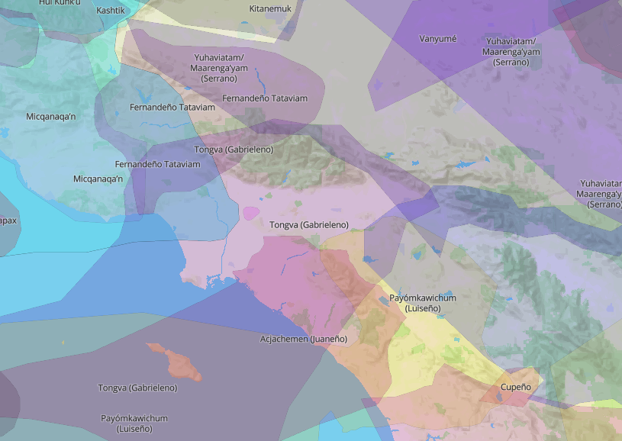
Statement of Land Acknowledgement
We acknowledge our presence on the traditional ancestral land of the Gabrielino/Tongva peoples who have lived and continue to live here. We recognize the painful history of genocide and forced removal. We honor and respect the Gabrielino/Tongva ancestors, traditional caretakers of this land, and their connection to this land.
Image Credit: NativeLandDigitalMap www.native-land.ca

Slide 3
Agenda
Welcome
Equity Brainstorm
Equity & the CCCs
Equity & ACCJC
Equity in Online Classes – The Peralta Online Equity Rubric
Key Criteria for Course Design & Delivery
Key Criteria for Instructional Technology
Applications of the Peralta Equity Rubric
This Photo by Unknown Author is licensed under CC BY-SA

Slide 4
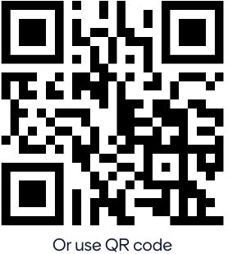
Mentimeter Brainstorm
Go to: www.menti.com
Enter code: 00 00 00 0 https://www.menti.com/xxxx15356
Image Credit: Shane Rounce on Unsplash

Slide 5
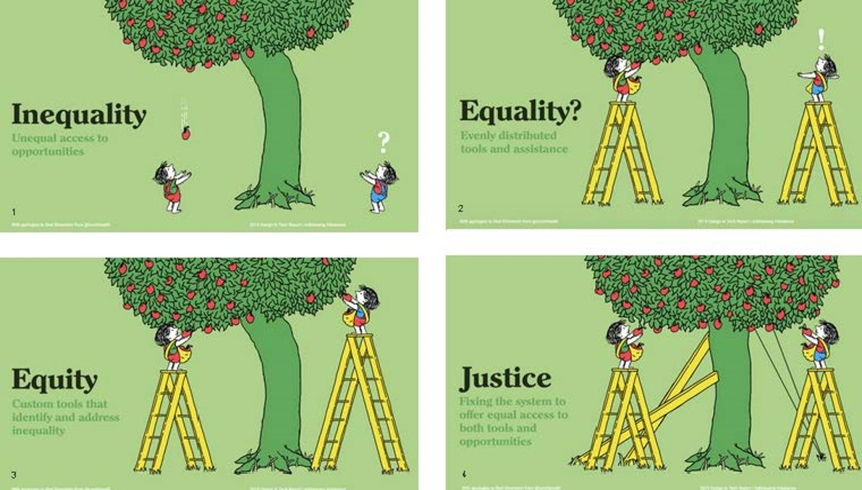
Equity, Diversity and Social Justice: Let’s Foster Them!
Image Credit: Design in Tech Report/

Slide 6
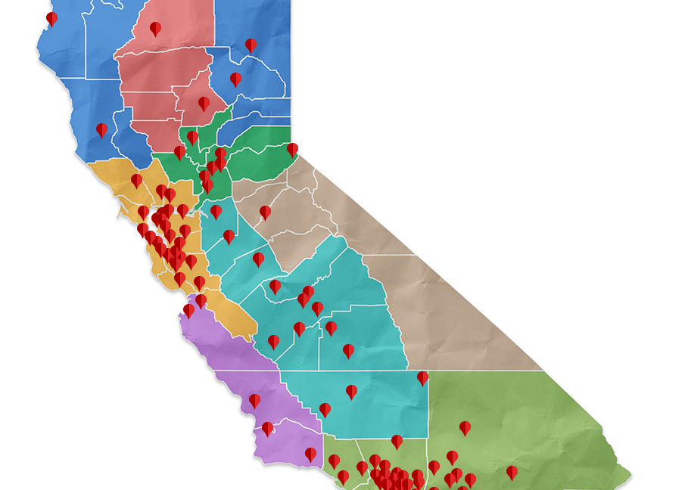
Our California Community Colleges: Some Quick Stats
115 Accredited CCCs
The largest higher ed system in the nation
2 million students per year
69% of our students are of diverse ethnic backgrounds
The CCCs offer over 10,000 online courses

Slide 7
Equity : Limitations and Biases
Image Credit: Gerd Altmann, CCO Public Domain

Slide 8
Equity & the ACCJC Vision for Success: 2021 Revision
Difficulties Facing our Students since 2020:
Students are in worse shape financially
More students have become housing or food insecure
Students are experiencing fresh pain and trauma from racial injustice
Students' mental health is suffering
The pandemic has exacerbated the digital divide
Some students are stepping away from their education paths

Slide 9
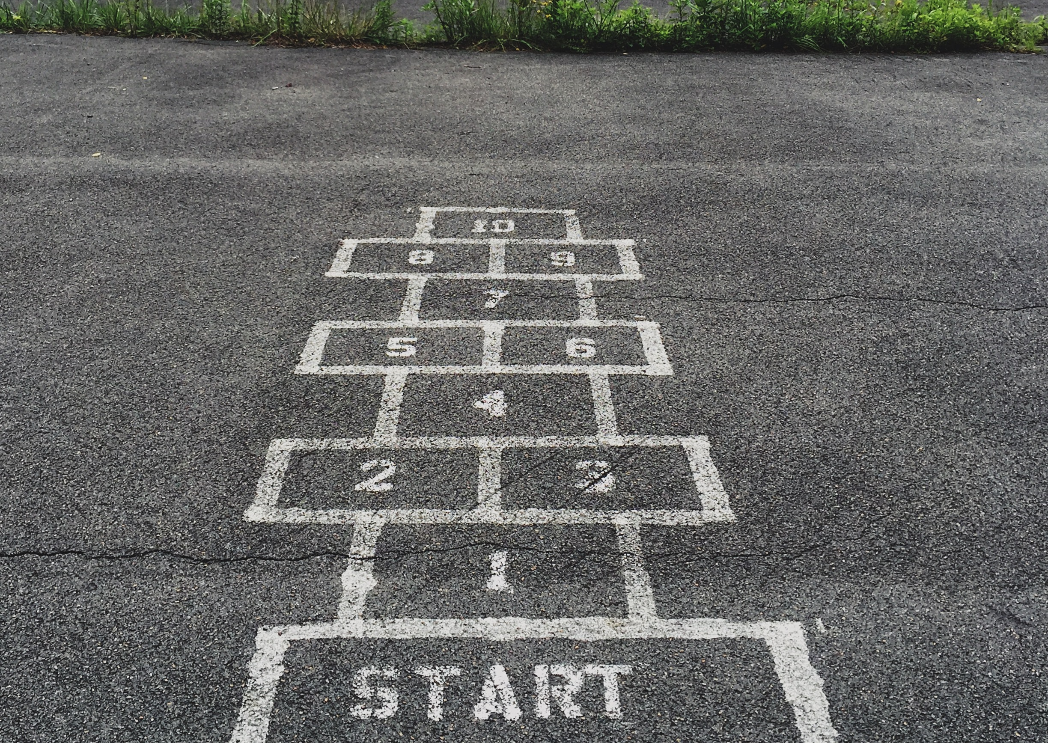
The ACCJC Vision for Success: Social Justice
Image Credit: Jon Tyson on Unsplash

Slide 10
Equity in Online Classes: The Peralta Online Equity Rubric
Key Criteria for Course Design & Delivery
Key Criteria for Tools
Technology
Diversity & Inclusion
Images and Representation
Content Meaning
Connection & Belonging
Universal Design for Learning
Human Bias

Slide 11
Technology in Online Classes: The Peralta Online Equity Rubric
E1: Technology
Basic questions to ask:
Do my students need dedicated online access to interact with the tool or content/complete tasks?
What is the cost of the technology for my students?
Does this technology add to my students’ learning experiences?
Course structure & activities mitigate digital divide & technology access issues (a) by clarifying how required technologies support learning, and (b) by providing alternative pathways to complete course activities if students face barriers.
Examples:
Open Educational Resources
Text-based Content
Downloadable Content

Slide 12
Universal Design for Learning: The Peralta Online Equity Rubric
E3. UDL
Course content and activities are aligned with core principles of UDL-- i.e., multiple means of representation, action & expression, and/or engagement.
Basic questions to ask:
Are my materials/tools accessible (able to be used by all regardless of ability)?
If not, do I provide an equal and equitable alternative?
Do I have a range of materials to allow for learner preference (video, text, audio, etc.)?
Can I scaffold my assessments/tasks so that students are doing them step-by-step incorporating strategies & support?
Do the tools I use have alternatives for students?
Examples:
Videos
Accessible Content
Support/Instructions

Slide 13
Human Bias: The Peralta Online Equity Rubric
E6. Human Bias
Human biases are identified in course content and activities.
Basic questions to ask:
Do the tools I use have the potential for a negative “impact on motivation and persistence”?
If yes:
Ask yourself why the tool needs to be used
How you can think of ways to alleviate that impact.
Alternatives that create community and address diversity.
How does the vendor represent students in their support and online materials?
How can I get students to reflect on/provide feedback on their experience more equitably (survey, ePortfolio, reflections, journals)?
Examples:
Multiple forms of representation
Choice/options
Reenvisioning our world
Support/Instructions

Slide 14
Examples: Course Tour
Image Credit: ©sandrahaynes2012

Slide 15
Examples: Tour Stops
The Peralta Online Equity Rubric
F2: Diversity and Inclusion are explicitly valued through course content and assignment that acknowledges the importance of inclusivity.​
F3: Images and representations of people are diverse, and/or the instructor encourages students to analyze representations and stereotypes​
F4: Human Interaction biases are acknowledged and assignment encourages ongoing learning about human biases​
F5: Content Meaning element includes a course activity that requires students to connect course content to their socio-cultural backgrounds and/or socio-cultural backgrounds of others​
F6: Personal Connections through a course activity/assignments requires students to interact in ways that value diverse student experiences and perspectives​

Slide 16
Resources
ACCJC Revised Policy on Social Justice
CCCs Vision for Success, 2017, updated July 2021
Equity-Minded Worksheet for Instructors of Online Classes (University of Wisconsin)
Shoemate, Joy. Open for Anti-Racism Course (Canvas Commons)
Peralta Online Equity Rubric
Racial Equity Tools
UDL – Cast.org
This Photo by Unknown Author is licensed under CC BY

Slide 17
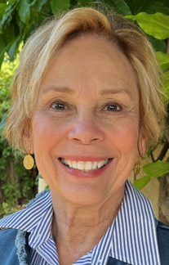
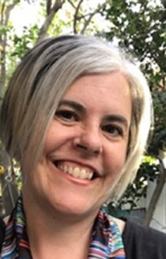
Contact Information
June 29 - July 1, 2022
Sandy Haynes:
schaynes@pasadena.edu
professor.shaynes@gmail.com
Katie Datko:
cdatko@mtsac.edu

