Slide 1
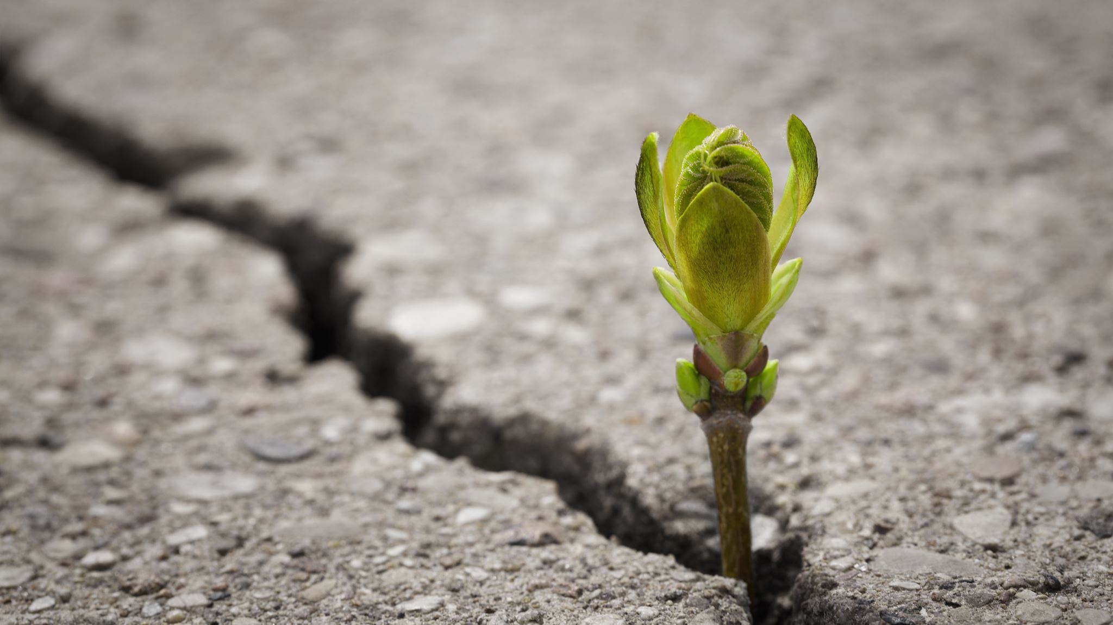
A Journey Toward Equitable Assessment
Online Teaching Conference 2022
Amanda Taintor, Julie Kehoe, & Jennifer Paris

Slide 2
Issues with Traditional Grading & Assessment
Focused on point earning
Some students give up
Grades didn't reflect what students had learned
Outcome assessment and grades didn't align
Enforcement of rules got in the way of building relationships with students
Notes:
Focus on learning
Opportunities for redemption
Motivational
Customized learning experience
Accurate grades that reflect learning
Outcome assessment aligns with grades
Better relationships with students

Slide 3
Risk Taking and Growth Mindset
“If everything about me in a class is judged and included in a grade,… my grades say not what I’ve learned in the subject so far, but who I am”​
When everything is graded then there is no safe place for mistakes
But learning cannot occur WITHOUT mistakes
Leads to cheating
Losing points for mistakes DURING the learning process
mistakes are NEVER acceptable. ​
=
This Photo by Unknown author is licensed under CC BY.
Notes:
Mistakes are not only important to learning but learning cannot occur WITHOUT mistakes
When students lose points for mistakes DURING the learning process, the message is that mistakes are NEVER acceptable.
These high expectations can often lead to cheating

Slide 4
Extrinsic Motivation
Using points as motivation assumes this is the best way to motivate
BUT
Research shows extrinsic rewards are not an effective motivation strategy for authentic learning.
Students have been trained to seek points
BUT
They will be motivated by learning if we unburden them from
the stress and anxiety of grades
Notes:
Using points to motivate students assumes that extrinsic motivation- rewards and consequences provided by the teacher – is the most effective way to promote learning.
However, research show that extrinsic rewards are not an effective motivation strategy for authentic learning.

Slide 5
Students who learn the material should pass.

Slide 6
Move beyond our traditional way of grading

Slide 7
Grading: Reconsidering
grade scale*
late penalties & deadlines*
graded homework
participation/effort points
extra credit
retakes & resubmission
This Photo by Unknown author is licensed under CC BY-SA-NC.
Notes:
Be based on valid evidence of a student's content knowledge
Provide all students an opportunity to succeed regardless of their environment
What are the environmental factors that hinder success that we can control by simply thinking about our accurate grades
Ie extra credit for attending some additional event on campus--> what about those students who work other jobs? Childcare? Transportation?

Slide 8
Grading scale comparison
0-100 Scale
0-4 Scale
0-4 Scale
Punishments for missing assignments is proportional
No hole a student can't dig out of
0-100 Scale
Wide Variance
What's the difference between a 69 and a 70?
Weighted towards failure
Makes it difficult, sometimes impossible, to bring a grade up to passing level
40%
60%
A | 3.5-4.0 | 87.5-100%
B | 2.75-3.49 | 68.75-87.4%
C | 2.00-2.74 | 50-68.74%
D | 1.25-1.99 | 31.25-49.9%
F | Below 1.25 | Below 31.25%

Slide 9
Effectively Facilitating Learning
Break down outcomes of the course into discrete skills students need to have
Make clear purpose of all assignments – tied to outcomes
Backward design to ensure that all outcomes are scaffolded
Provide different ways for students to showcase learning (universal design)
This Photo by Unknown author is licensed under CC BY.

Slide 10
Skill Outcome Alignment
SLO 1: Demonstrate strategies to promote healthy relationships in the care and education of infants and toddlers
Skill 1.1 Attachment
Skill 1.2 Caregiver Responsiveness
Skill 1.3 Connecting Routine Care to Relationships
Skill 1.4 Identify Reciprocal Communication
Skill 1.5 Identifying Principles of Practice
Skill 1.6 Respectful Caregiver Interactions
This Photo by Unknown author is licensed under CC BY-SA.

Slide 11
Flexible Deadlines
"due dates" to keep on pace
No need to request extensions
Time Management Skills (the good and the bad)
Notes:
Not many teachers would disagree with these statements. It not something we would say "yeah, I like my grades to be complicated based on bad math and tied to arbitrary things" But why are our grades NOT these things.
Elaborate on time management issues and good parts

Slide 12
Feedback & Communication
Detailed rubrics
Provide feedback
Consistent narrative
This Photo by Unknown author is licensed under CC BY-SA.

Slide 13
Example Rubric
Integration by Parts: Identify when to use integration by parts and implement the technique.
0 - Insufficient Evidence | 1 - Not Yet Met Standard | 2 - Approaching Standard | 3 - Met Standard | 4 - Exceeds Standard
No meaningful work submitted Did not use integration by parts Correct answer may have been given with no work to support it | Identified that Integration by Parts should be used. Did not correctly choose u, du, dv, and v The integral was not setup and correctly. | Used the correct u, du, dv, and v The integral was not integrated correctly. Too many steps were missing to provide a clear explanation of the solution. | Used the correct u, du, dv, and v The integral was setup and integrated correctly with some steps missing or minor mistakes present. Algebraic mistakes may be present. | Correctly identified and labeled u, du, dv, and v The integral was setup and integrated correctly without skipping steps Minor arithmetic mistakes may be present.

Slide 14
Retakes and Submissions
Submit --> Feedback--> Submit
This Photo by Unknown author is licensed under CC BY-NC-ND.

Slide 15
Questions?
Julie.kehoe@reedleycollege.edu
Amanda.taintor@reedleycollege.edu
jennifer.paris@canyons.edu

